Slide 1
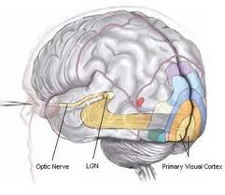
Areas in the visual cortex
Hierarchical processing of visual information
Each area represents the full spatial field
Different areas – different stages of the visual processing
Jansen and Vanduffel,
from Roe et al. 2012

Slide 2
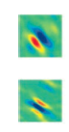
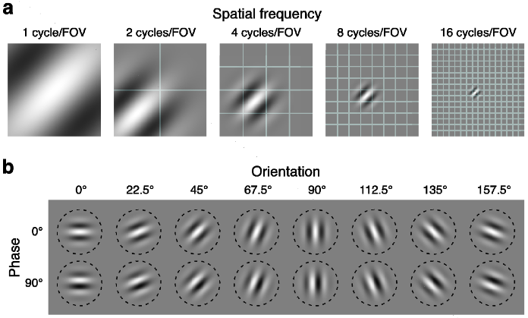
Early Visual System
Preprocessing an image into objects:
Simple Cells Receptive field model
Complex Cells Sensitive to edges Particular spatial frequency, location, orientations
Red area – increased activity Blue area – reduced activity
Single neuron recording Simple cells, V1 Macaque
Ringach, 2002
Represented by
Gabor Filters, static or dynamic

Slide 3
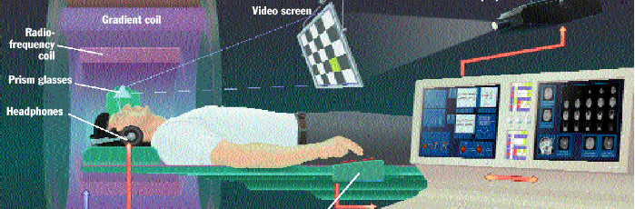
Studying the visual system with Functional MRI
Non-evasive but indirect measurement of brain activity
Measures oxygen in blood flow – a correlate of neural activity
Low temporal resolution (4-5 sec)
Dense spatial grid (2x2x2 mm³ voxels)
> 6000 voxels in early visual areas but, 1 voxel ~ 1 million neurons
Images can be displayed inside magnet

Slide 4
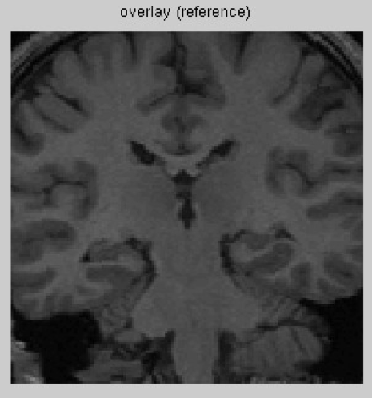
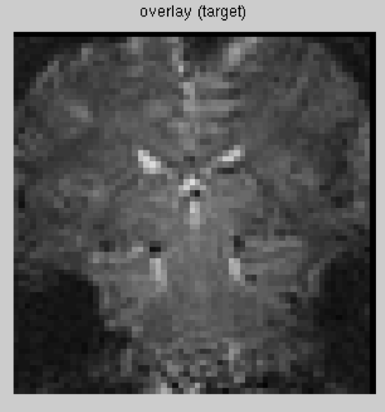
Functional MRI
Voxelized images
Registered to a high-resolution MRI
Gallant Lab

Slide 5
Natural Stimuli
Images
Gallant lab

Slide 6
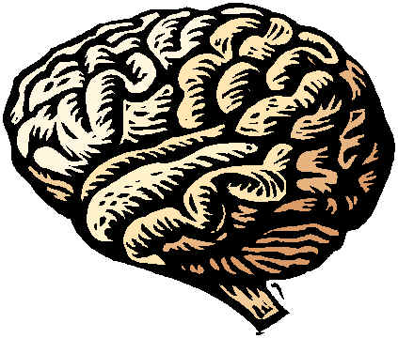
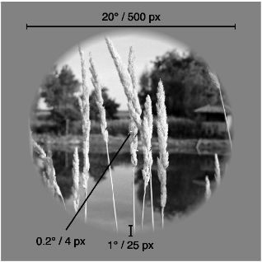

Encoding models
Computational models that give quantitative predictions for the measured neural activity evoked by a new stimulus.
(Figure from Shinji Nishimoto)
Brain
Natural stimuli
Observed activity
Predicted activity
Model
Activity
Stimuli #
[*] Out of sample prediction, for same response and same individual

Slide 7
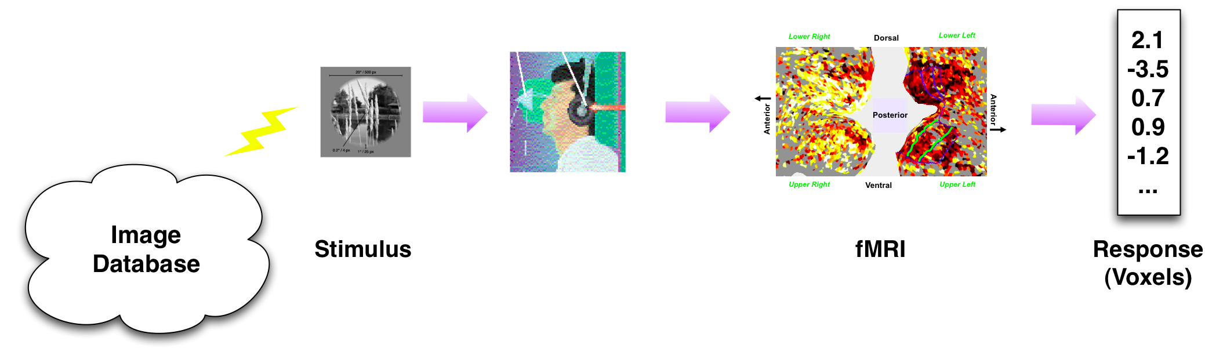
Experimental Setting
Kay et al (2008)
Natural image stimuli: ecological setting, rich effects
fMRI: measures blood flow – surrogate for neural activity
r =1250
Training
n =1750 (2 reps)
Validation
n_{v} =120 (13 reps)

Slide 8
Decomposing an image into wavelets

Slide 9
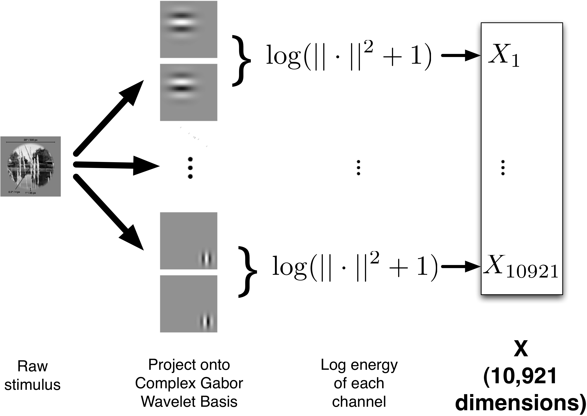
Quantifying (stimulus)

